Slide 1

DATABASE PROJECT Panel Paradise
Abdallah Mohamed Ramadan:211002284
Ahmed Abdel Nasser:19101106
Mohamed Saeed:211001228

Slide 2
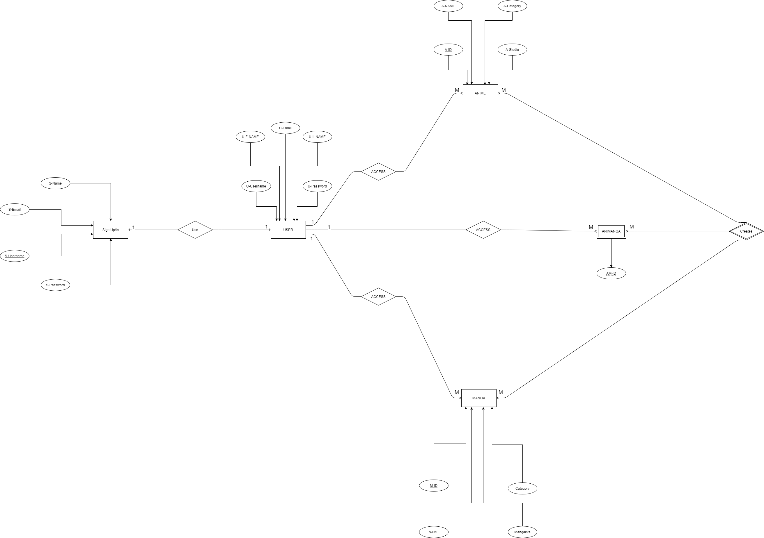
ERD Diagram:

Slide 3
Schema
Relational Schema:
Login/Register(Username,FName,LName,Email,Password )
User(Username,Fname,Lname,Email,Password)
Anime(A-ID,A-Name,A-Studio,A-Category)
Manga(M-ID,M-Name,M-Mangakka,M-Category)
AniManga(A-ID,M-ID,AM-ID)
Creates(A-ID,M-ID,AM-ID)
Normalization 3F:
Login/Register(Email,Password,Fname,LName)
User(Username,Password)
Anime(Anime-ID,A-Name,A-Studio,A-Category)
Manga(Manga-ID,M-Name,M-Mangakka,M-Category)
Creates(AM-ID)
AniManga(A-ID,M-ID,AM-ID)

Slide 4

CODE

Slide 5
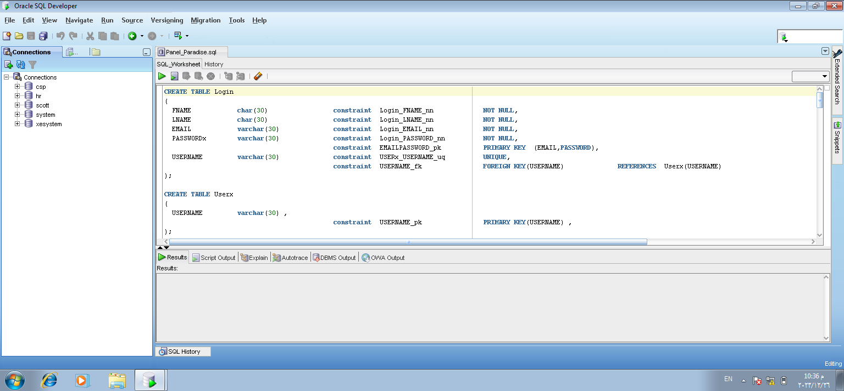
Login & User
(Table Creation)

Slide 7
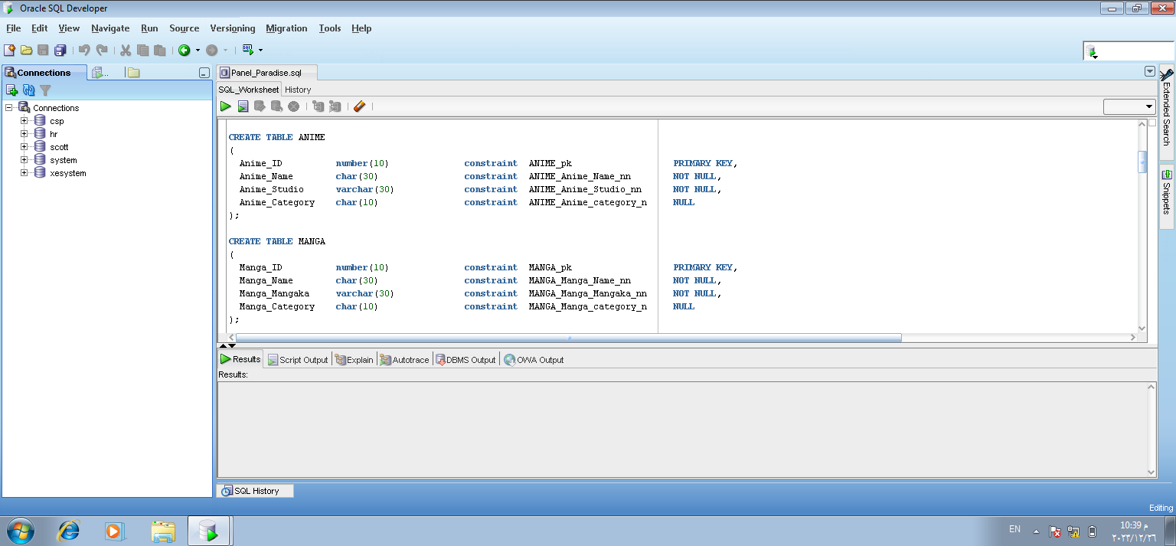
Anime & Manga
(Table Creation)

Slide 9
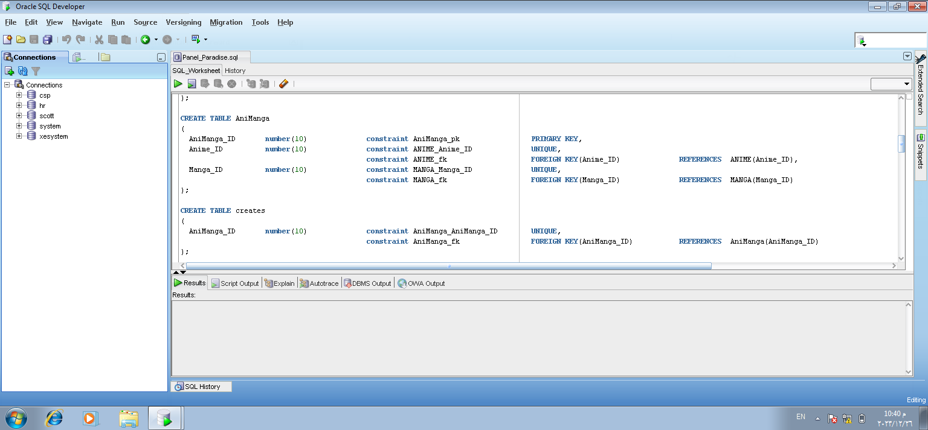
AniManga & Creates
(Table Creation)

Slide 11
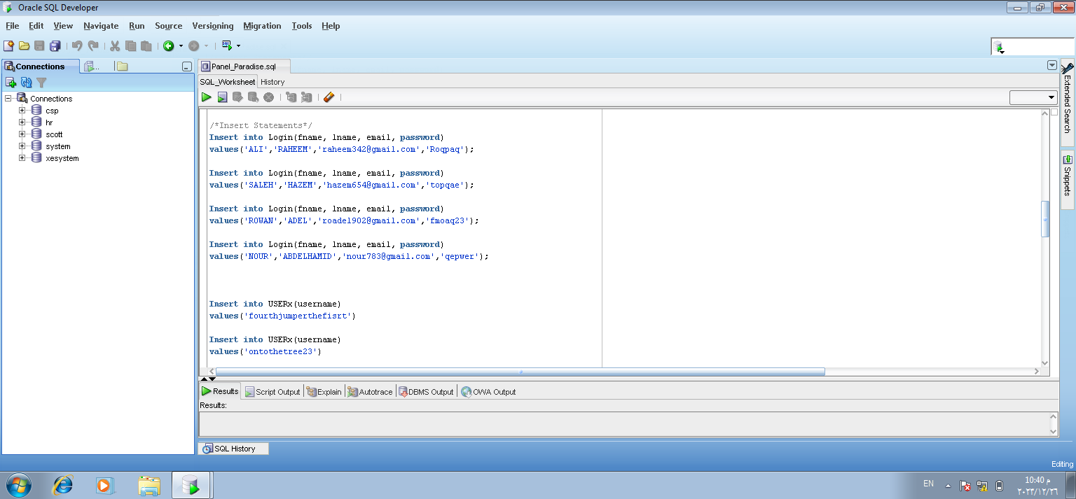
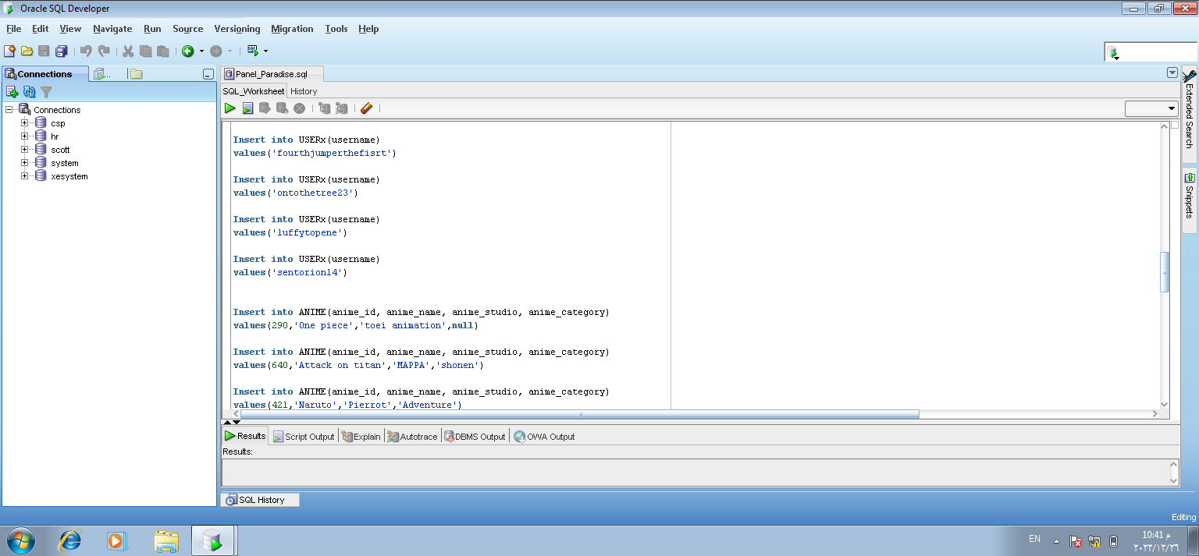
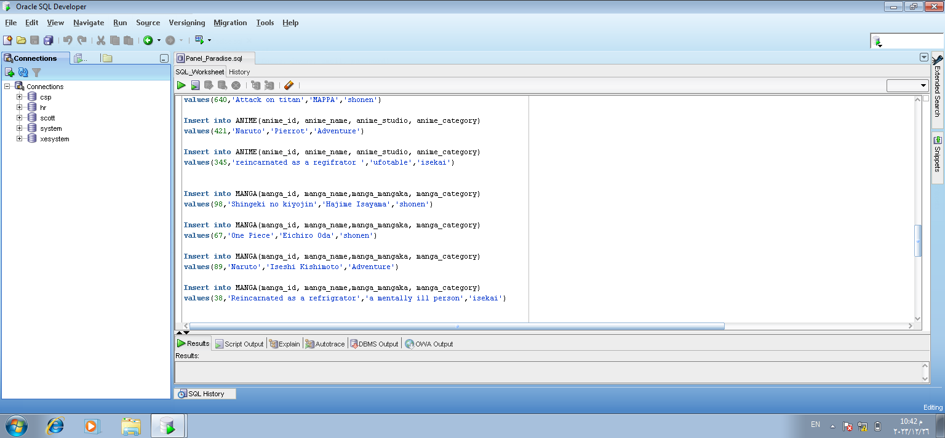
Insert Statements

Slide 15
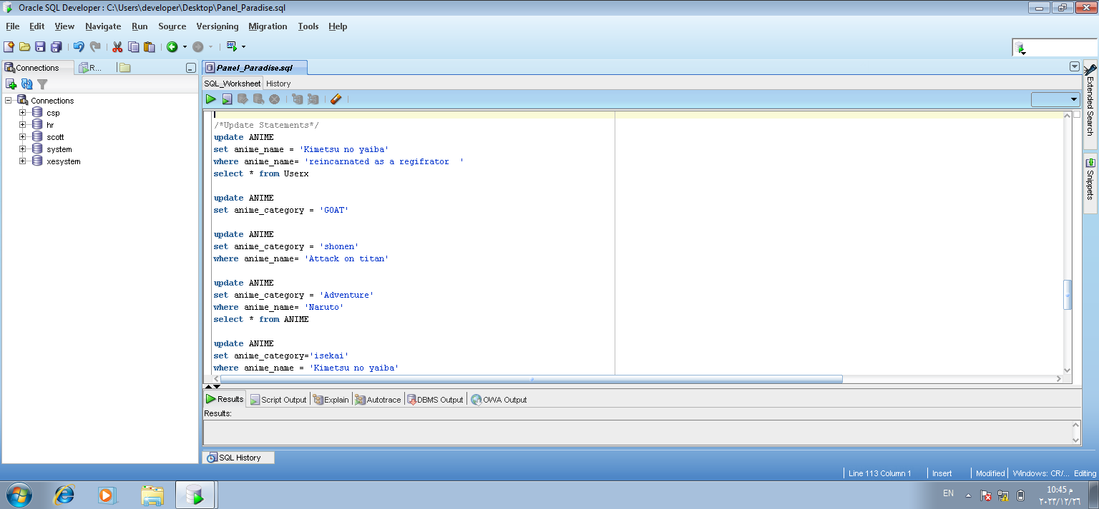
Update Statements

Slide 17
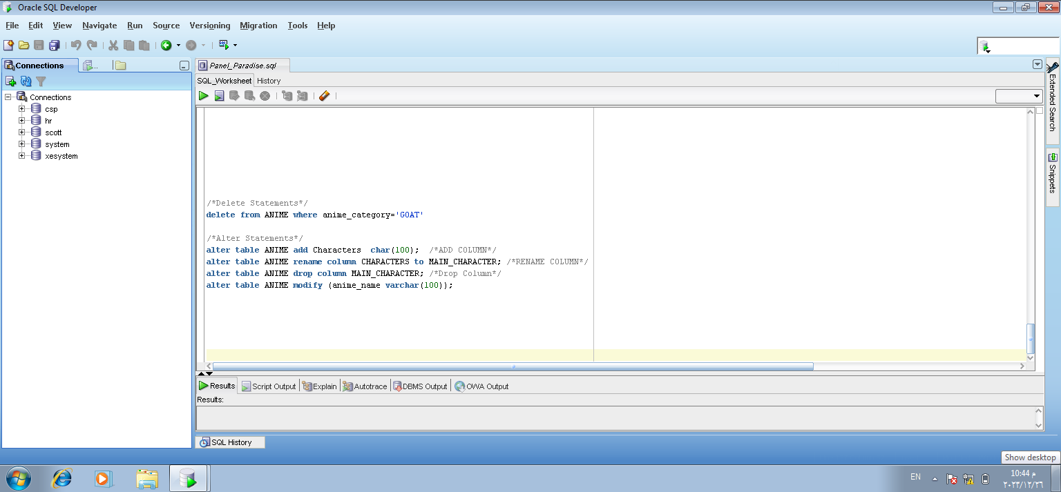
Delete & Alter Statements

Slide 19

Tables

Slide 20
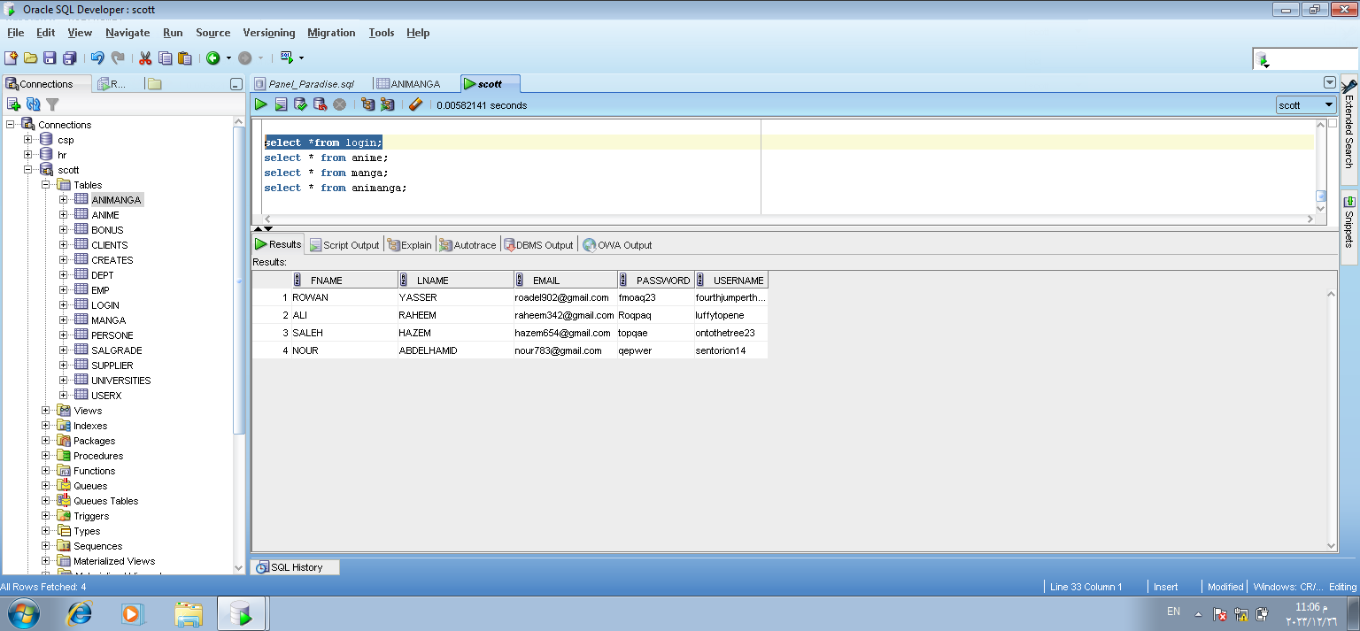

Slide 21
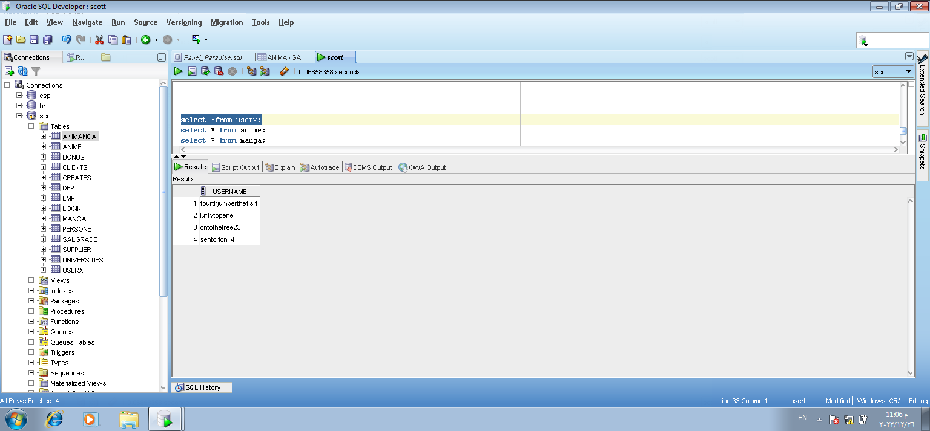

Slide 22
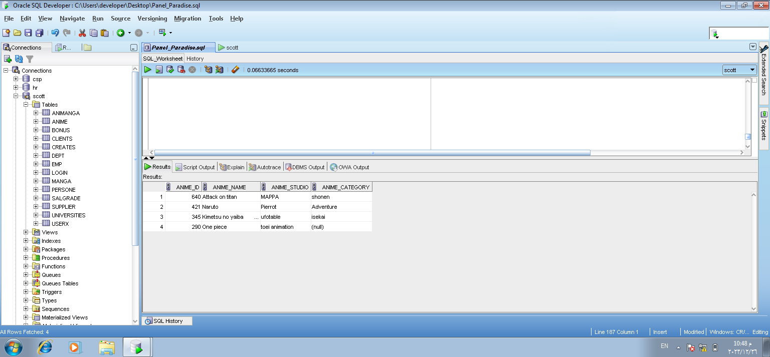

Slide 23
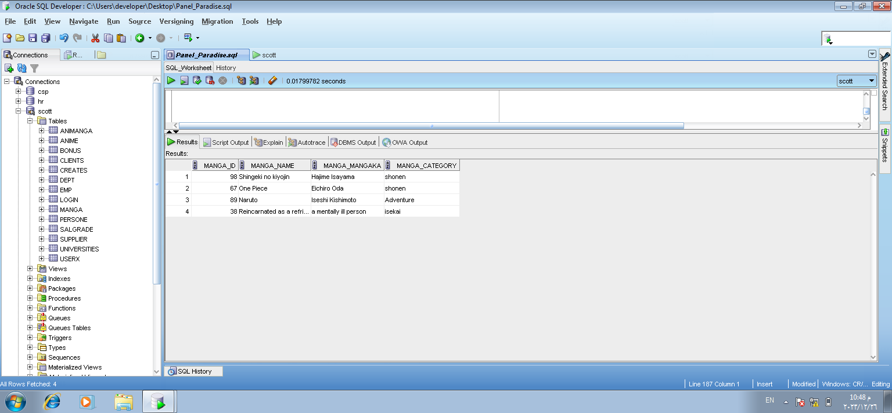

Slide 24
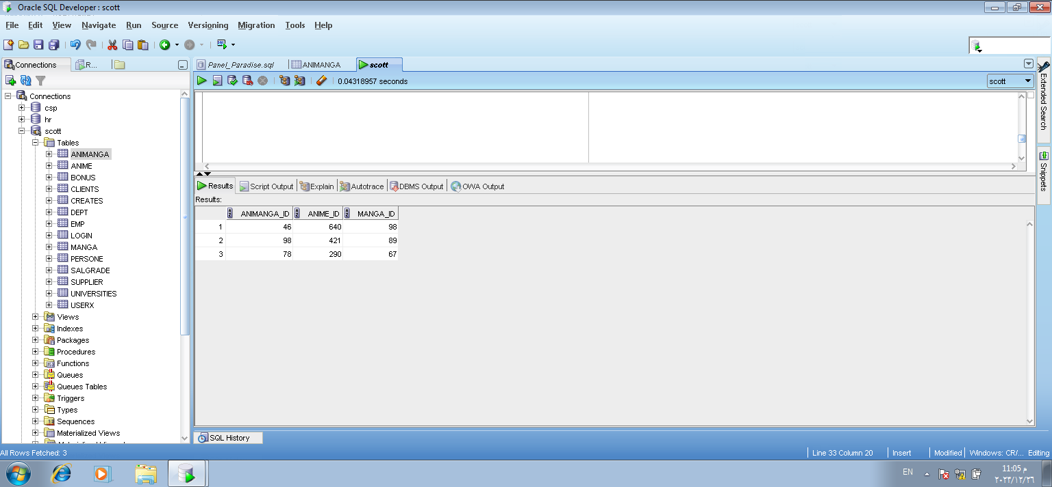

Slide 25
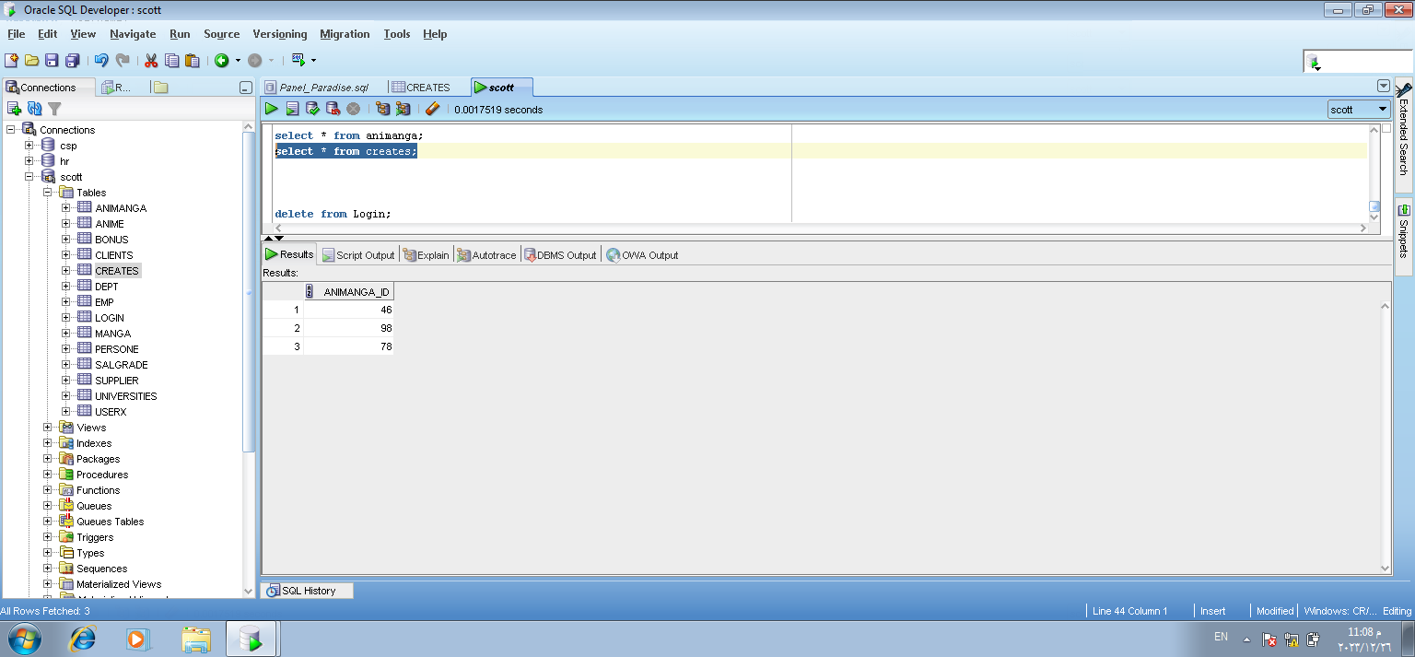

Slide 26

This is all thank you for your time

